Slide 1
Adolescents’ Salt Reduction Consciousness, Attitudes and Behavior
Jialiang Jin, Xingjian Wang, Jiatong Chen, Jiayv Fu
AP Statistics Final Project

Slide 2
1. Research Question
2. Background Research
3. Sampling and Experimental Design
4. Exploratory Data Analysis
5. Problems & Suggestions
6. Conclusion

Slide 3
A: RESEARCH QUESTION
Aim
Investigate the awareness, attitude, and behavior.
Chinese Dietary Guidelines
Reduction in recommended daily salt intake from 6 grams to 5 grams.
But per capita daily salt intake in China still exceeds WHO recommendations.
Limited studies have focused on salt intake among adolescents.
The null hypothesis
No relationship between knowledge score and adolescents' salt control behavior.
Expectations
Identify factors influencing salt reduction behavior and willingness to reduce salt intake among adolescents.

Slide 4
B: BACKGROUND INFO
Harm of High-salt diet:
Causes cardiovascular damage. (Lenda & Boegehold, 2002)
Deviation between awareness and behavior on salt reduction:
Only 30% of respondents took actions(Bao et al, 2014).
Young people—> more likely to consume excessive salt(Chen, 2020).
Importance of study:
Adolescents’ dietary habits impact long-term health. (Zhao Yifan, 2019)
Insufficient studies focused on adolescents.
Current finding:
adolescents have low awareness and knowledge of salt dangers.(Shen T.Y, 2013)

Slide 5
C: METHODS & PROCEDURES
Sampling method& condition check
Sampling Method
Simple random sampling (SRS) used.
List of 718 students in BNDS International Department.
Assigned numbers to each student.
Randomly selected 65 students without repeats.
Collected 61 valid answer sheets.
Condition Check:
Randomly selected 61 samples using SRS.
Sample size (61) is less than 10% of all international department students.
All expected counts are larger than 5.

Slide 6
C: METHODS & PROCEDURES
Data collection
Questionnaire designed by the group
First part: Basic diet investigation (frequency of paying attention to personal daily salt intake, attention to nutrition knowledge)
Second part: Nutritional knowledge test for high salt (10 questions, single-choice format based on relevant research paper)
Third part: Overview of demographic variables (year of birth, gender, height, weight, school)
Demographic variables placed at the end to avoid respondent bias

Slide 7
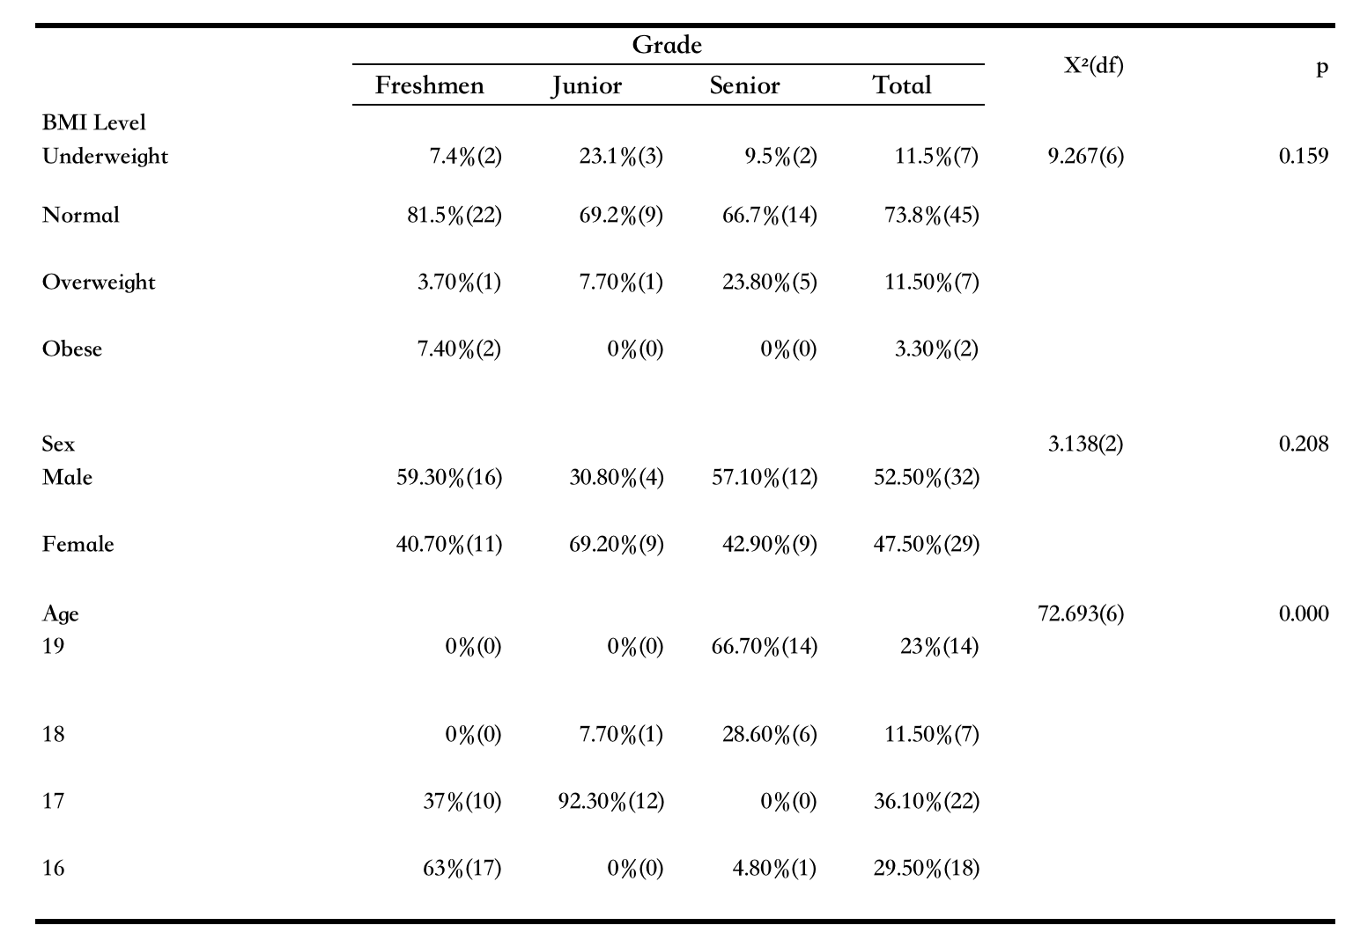
D: RESULTS
Table I: Summary of Demographic Characteristics of the Sample
Distribution of Sample
The sample consists of students from different grades
The proportions of gender are approximately even.

Slide 8
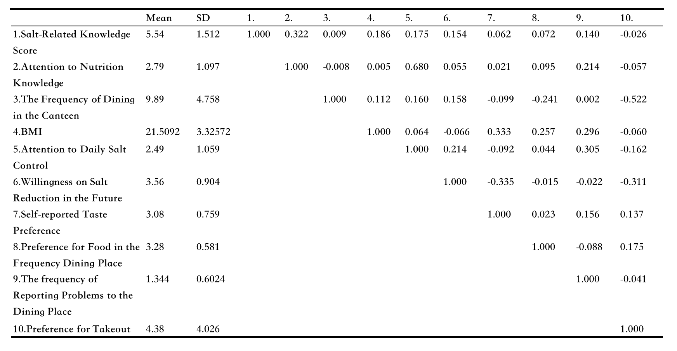
D: RESULTS
Table II: Descriptive Statistics of each Variable and Correlation Coefficient Matrix
Mean & SD
1--> Only half of questions correctly answered
2&5--> Low awareness & attention to nutrition or salt-related knowledge
6& 5,8-->
High willingness, low action
Discrepancy between their intentions and their actual behavior.

Slide 9

D: RESULTS
Table II: Descriptive Statistics of each Variable and Correlation Coefficient Matrix
Correlation
Salt-related knowledge test score
--> knowledge of nutrition.
Attention to dietary salt
--> knowledge of nutrition.
Attention to dietary salt
--> giving feedback to school restaurants about food taste.
Taste index is correlated with BMI.
BMI
--> the tendency to give feedback about food taste.
Self reported taste preference is negatively, weakly correlated with willingness of salt reduction

Slide 10
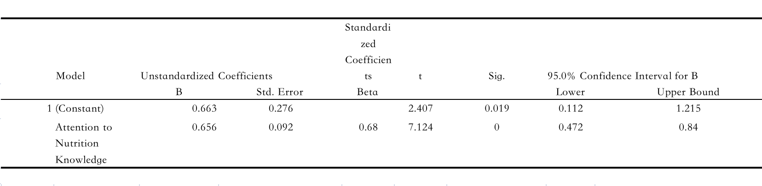
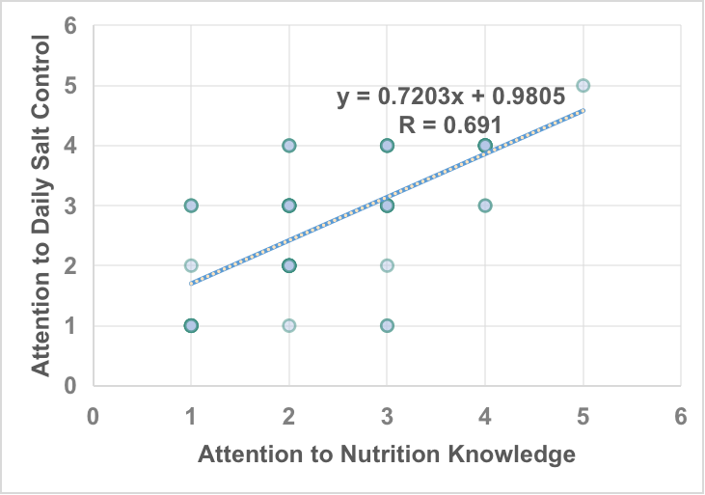
D: RESULTS
Table III: Computer Output for Linear Regression Line on Attention to Daily Salt Control and Attention to Nutrition Knowledg
Strong linear correlation: attention to dietary salt (y) knowledge of nutrition (x).
Students with more knowledge of nutrition tend to pay more attention to salt intake and give feedback to school restaurants.
Figure 1: The linear Regression Line between Attention to Daily Salt Control and Attention to Nutrition Knowledge

Slide 11
D: RESULTS
Test Score -->reflects mastery to nutrition knowledge-->strongly positive related to attention to daily salt control
Individuals with high attention to daily salt control tend to give feedback about salt content in dining place
Individuals with high BMI tend to give feedbacks but they are unrelated to salt
Those with heavier taste and attention to daily salt control are unwilling to reduce salt in food

Slide 12
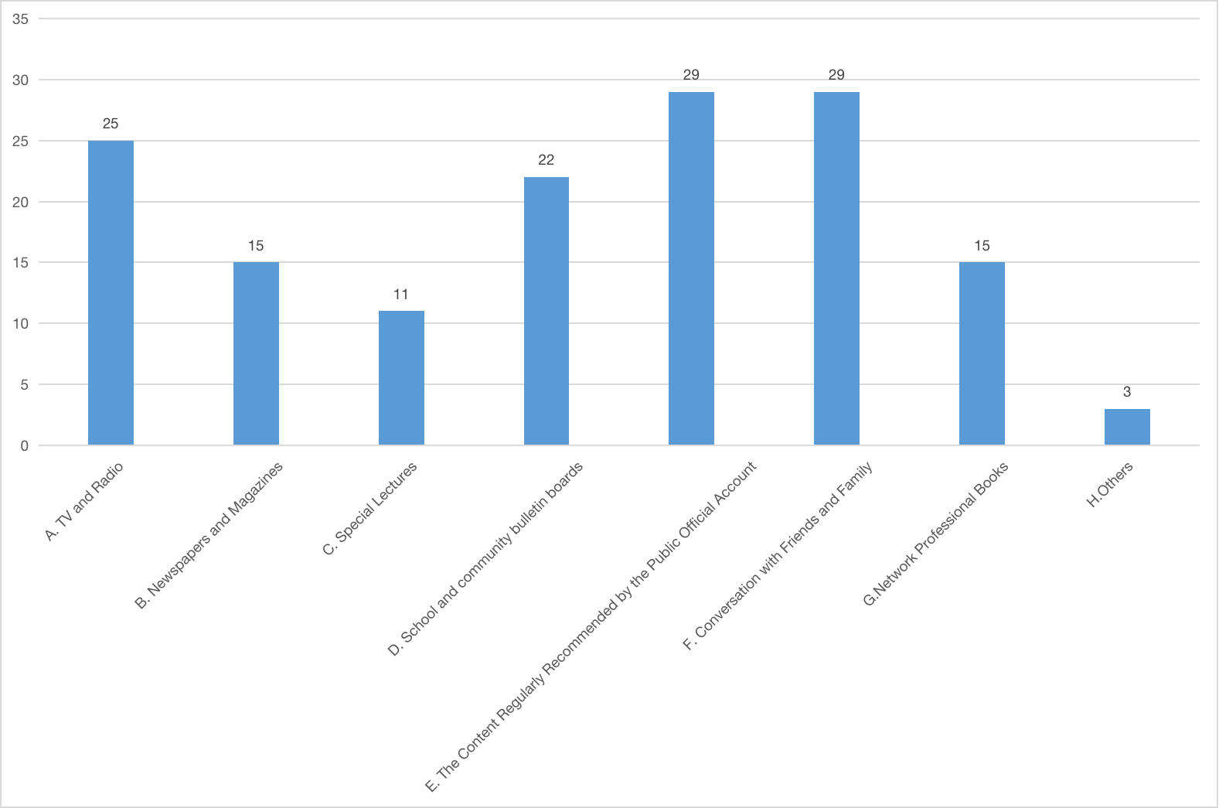
D: RESULTS
Talk with their relatives and friends and content recommended by public official account as well as TV and radio
Improvement of students' salt control awareness can be started from home and the places where adolescents spend most of their time with their friends to promote cooperative education and popularization of science on the network platform
Figure 2. The Sources of Nutrition Knowledge among Adolescen

Slide 13
E: PROBLEMS/ SUGGESTIONS
Limitations
Only 10 test questions that measure the salt-related knowledge
Low construct validity.
Small sample sizes--> smaller scope of generalization.
Difficulty defining "salt reduction awareness" and measure“salt control behavior”.
Suggestions
Develop a test to quantify the "salt reduction awareness"
Use 24-hour urine sodium level & Food Frequency Questionnaire
Explore other factors influencing adolescents' awareness of salt reduction
Family
Policies of Dining Places

Slide 14
F: CONCLUSION
The salt reduction behavior mainly rely on the degree of attention and mastery of nutritional knowledge
The gap between their willingness to reduce salt consumption and actual behavior
Teens who are not willing to reduce salt are flavored heavy and high in bmi
Advertise and through school activities and network platform

Slide 15
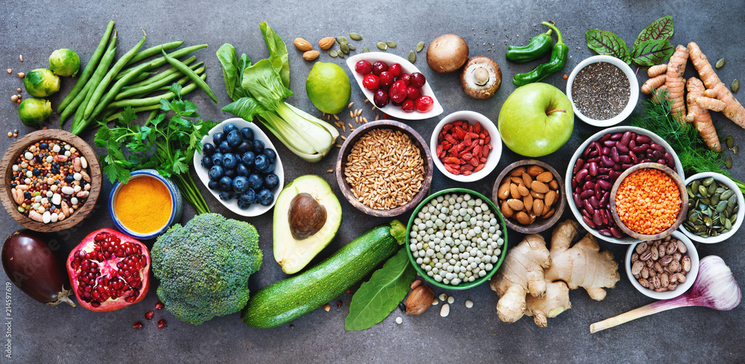
References
Anyaegbu, E. I., & Dharnidharka, V. R. (2014). Hypertension in the teenager. Pediatric Clinics, 61(1), 131-151.
Bao, J. S., Cheng, Y. Y., Yang, Y. X., & Wang, Z. (2014). "Assessment of salt reduction knowledge and barriers to behavior change among Chinese residents." Acta Nutrimenta Sinica, 36(5), 421-425.
Chen, S., Shan, L., Tao, W., Lu, T., Regan, Á, Han, H., ... Wall, P. (2020). A survey of Chinese consumers’ knowledge, beliefs and behavioural intentions regarding salt intake and salt reduction. Public Health Nutrition, 23(8), 1450-1459.
Chinese Nutrition Society. "Chinese Dietary Guidelines for Residents (2022)." Beijing: People's Medical Publishing House, 2022.
Jiang, Q., Ji, G. Y., Hong, X. M., & Chen, Z. H. (2018). "Salt and Health." South China Journal of Preventive Medicine, (1), 79-82.
Lenda, D. M., & Boegehold, M. A. (2002). Effect of a high-salt diet on oxidant enzyme activity in skeletal muscle microcirculation. American Journal of Physiology-Heart and Circulatory Physiology, 282(2), H395-H402.
Li, J. H., Lu, Z. L., Yan, L. X., Zhang, J. Y., Tang, J. L., Cai, X. N., ... & Xu, A. Q. (2014). A comparison of the weight method, frequency method, and 24-hour urinary sodium excretion method for assessing salt intake in the population. Chinese Journal of Preventive Medicine, (12), 1093-1097.
Shen, T. Y., Ma, Y. H., Zhang, P. H., Lu, L. X., & Gao, X. (2013). Oil and salt knowledge and dietary behaviors among primary and secondary school students in Xicheng District, Beijing. Chinese Journal of School Health, 34(8), 932-933.
Xiao, C. L., You, K., Cheng, W. L., Zhang, Y., Zhang, S. W., Zhao, H. Y., & Li, C. Q. (2017). "Investigation of salt-related knowledge, beliefs, and behaviors among primary and middle school students in Shunyi District, Beijing." Occupational and Health, 33(8), 1114-1116.
Xu, J. (2014). Research on the strategies for implementing salt reduction in China (Doctoral dissertation, Beijing: Chinese Center for Disease Control and Prevention).
Zhao, F., Zhang, P. H., Zhang, L., Gao, J. M., Lu, L. X., Liu, C. X., ... & Niu, W. Y. (2013). "The relationship between blood pressure and oil-salt intake in primary and middle school students in Beijing." Chinese Journal of School Health, (4), 439-442.
Zhao, Y. F., Ren, J., Liu, M., Chu, J., Xu, Z. J., & Yan, L. X., et al. (2019). "Analysis of the current status of salt-related knowledge, attitudes, and practices among 6-17-year-old students in Shandong Province in 2016." Chinese Journal of Health Education, (2), 171-174.

Slide 16
THANK YOU FOR LISTENING!
The end

